Slide 1

Dell’s Blue Ocean Strategy
Presented By GROUP – 8
Members:
Praneet - (2302570049)
Anjali Sharma - (2302480001)
Sonal choudhary - (2302570019)
Noyal K Jiji - (2302570023)
Kshitij Gumber - (2302480028)

Slide 2

What Is Blue Ocean Strategy
The term "Blue Ocean Strategy" refers to a strategic approach in business that involves creating a new, uncontested market space that makes competitors irrelevant.
This concept was developed by W. Chan Kim and Renée Mauborgne in their influential book titled "Blue Ocean Strategy: How to Create Uncontested Market Space and Make the Competition Irrelevant."
The metaphorical "blue ocean" represents an untapped market space that is not yet explored by existing businesses. In contrast, the "red ocean" symbolizes existing industries where competition is intense, and companies are vying for a share of the market.

Slide 3

Key Blue Ocean creation
Dell's build-to-order business model began in the 1980s. Michael Dell founded the company in 1984. The build-to-order model, where Dell would assemble computers based on customer specifications, was a Blue Ocean strategy that set the company apart from its competitors.
Customization and Personalization
Brand Loyalty and Reputation
Efficient Supply Chain
Quick Response to Market Demands
Direct Sales and Customer Relationships

Slide 4
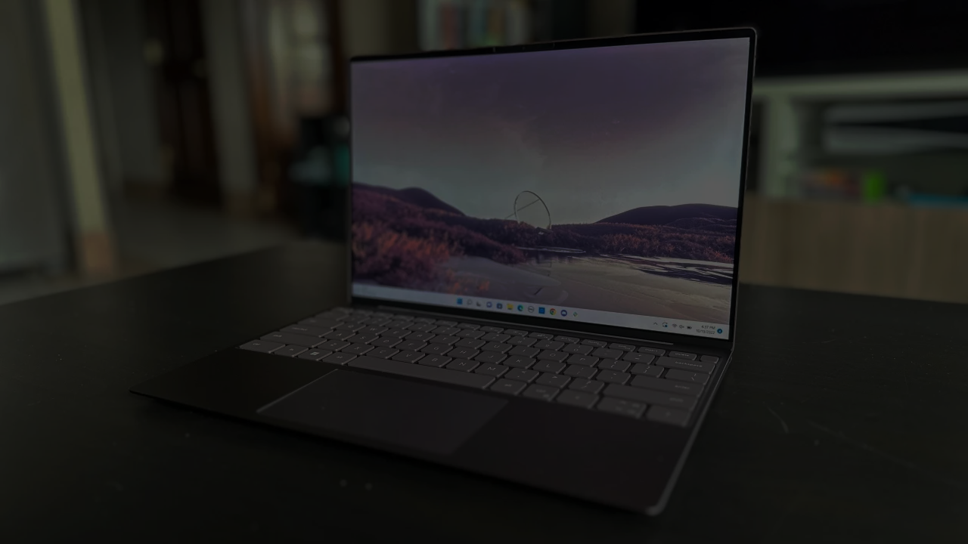
Was the Blue Ocean created by a new Entrant or an Incumbent
Dell, an established player in the computer industry, effectively implemented a Blue Ocean Strategy:
Incumbent Status: Despite being a well-established company with a reputation for traditional offerings and a direct sales model, Dell pursued a Blue Ocean Strategy.
Creating Uncontested Space: By offering customizable laptops, Dell successfully carved out uncontested market space within the laptop industry, setting itself apart from competitors.
Market Leadership: Dell's strategic execution enabled it to maintain its position as a market leader and expand its market share, showcasing that established companies can implement Blue Ocean Strategies effectively to remain competitive and innovative in evolving markets.
Market Insight: Recognizing shifting customer preferences in the laptop market towards personalized computing solutions, Dell acted on market insights.
Strategic Pivot: Leveraging its industry experience and reputation, Dell strategically pivoted within its existing market space, challenging its own business model to adapt to evolving market dynamics.
Customizable Laptops: Dell's Blue Ocean Strategy introduced customizable, build-to-order laptops, departing from standardized offerings, allowing customers to tailor laptops to their exact specifications.

Slide 5
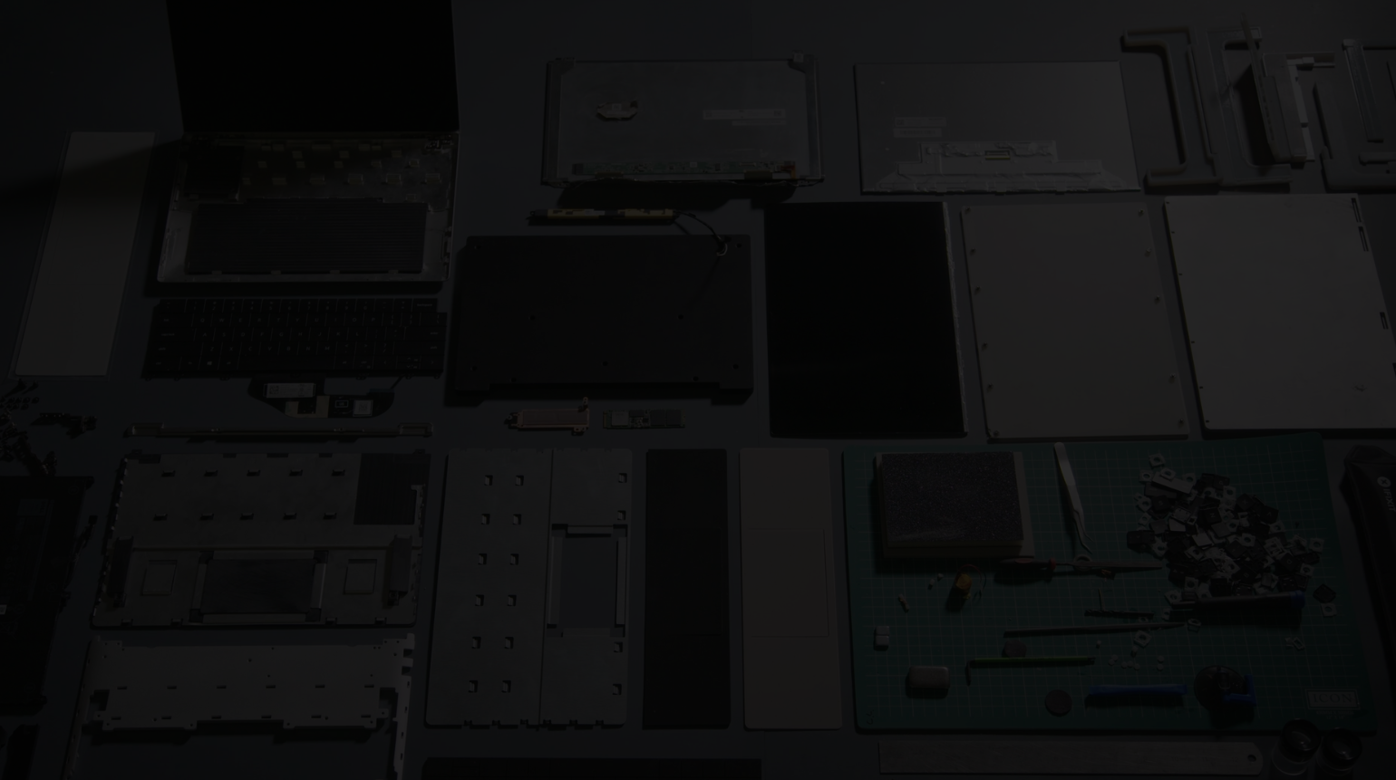
Dell's Blue Ocean Strategy for Laptops: Value Pioneering
Dell's Blue Ocean Strategy for laptops was underpinned by a profound emphasis on value pioneering, which played a pivotal role in its success.
Customization: Dell allowed customers to configure laptops to their exact specifications, meeting their individual needs and enhancing their user experience.
Efficiency: Dell's build-to-order system optimized manufacturing and inventory costs, reducing waste and offering customers better value for their money.
Customer Satisfaction: Dell's focus on customization and personalization translated into increased customer satisfaction, as customers received laptops that precisely met their expectations.
Competitive Advantage: Dell's ability to deliver customized laptops set it apart from competitors, especially those offering standardized products. This competitive advantage further added to the value Dell provided to its customers.

Slide 6

At the time of blue Ocean Strategy, was the industry attractive or unattractive?
The Dell built-to-order model disrupted the computer industry by addressing the inefficiencies inherent in the traditional approach.
Unlike the industry's reliance on standardized products and high inventory, Dell's strategy prioritized customer-centric customization, enabling a streamlined production process that significantly reduced costs.
The Dell built-to-order model challenged the status quo of the computer industry by addressing key pain points such as excessive inventory and limited customization.
By emphasizing customer customization, reducing inventory costs, and establishing a direct engagement approach, Dell was able to create a new market space where competition became irrelevant.
By directly engaging with customers and offering personalized products at competitive prices, Dell not only overcame the industry's weaknesses but also established a new market space, thereby illustrating the power of disruptive innovation under the Blue Ocean Strategy.
Dell's innovative built-to-order model revolutionized the industry by directly addressing these inefficiencies.

Slide 7


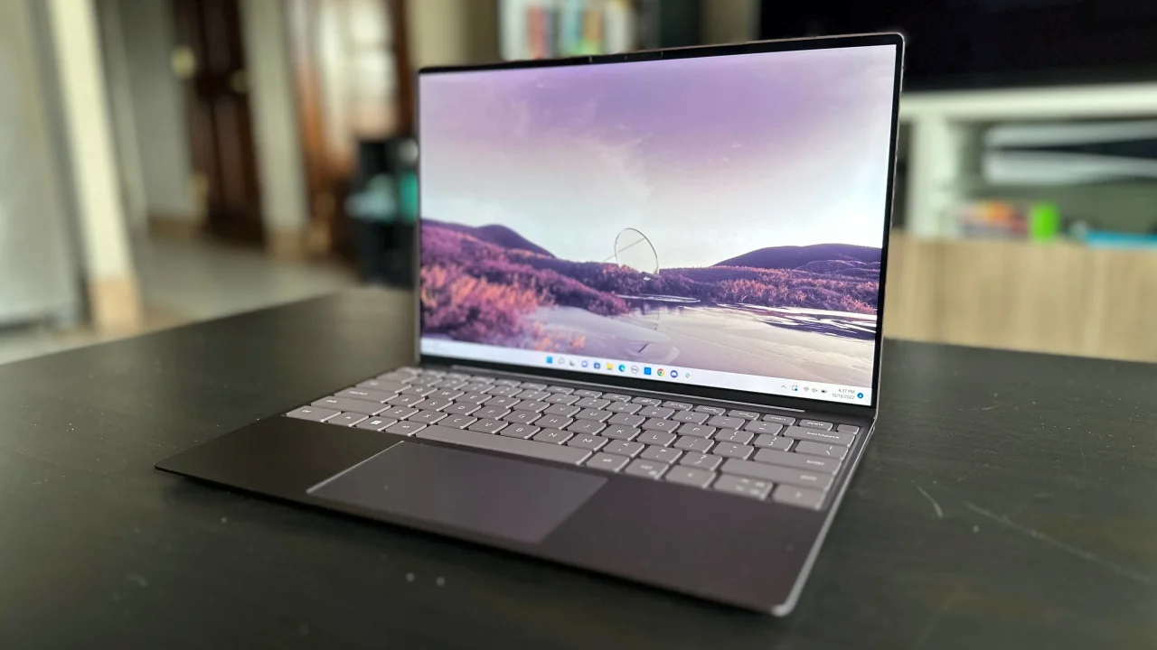

Conclusion
Dell's value-centric approach focused on customization, efficiency, and customer satisfaction, giving it a competitive advantage in the laptop market.
3. This strategy allowed Dell to not only cater to the specific needs of customers but also optimize production costs by manufacturing only what was required, leading to a significant reduction in overhead expenses.
4. By directly engaging with customers and offering personalized products at competitive prices, Dell not only overcame the industry's weaknesses but also established a new market space, thereby illustrating the power of disruptive innovation under the Blue Ocean Strategy.
2. Unlike the industry's reliance on standardized products and high inventory, Dell's strategy prioritized customer-centric customization, enabling a streamlined production process that significantly reduced costs.
9.This approach showcased how strategic innovation within the Blue Ocean framework can redefine entire industries and drive unprecedented success.
5. Brand Loyalty and Reputation: Dell's commitment to quality, customization, and customer satisfaction built a strong brand reputation. Satisfied customers often became loyal to the brand, leading to repeat business and positive word-of-mouth marketing.
7. Dell's innovative built-to-order model revolutionized the industry by directly addressing these inefficiencies.
6. The Dell built-to-order model challenged the status quo of the computer industry by addressing key pain points such as excessive inventory and limited customization.
8. By emphasizing customer customization, reducing inventory costs, and establishing a direct engagement approach, Dell was able to create a new market space where competition became irrelevant.

